Slide 1

Team- F

Slide 2
Members
Akshat Soni: 20CH10005
Arnepalli Jahnavi: 20EC10013
Mudita Srivatsa: 20CE30018
Vasav: 20NA10043

Slide 3
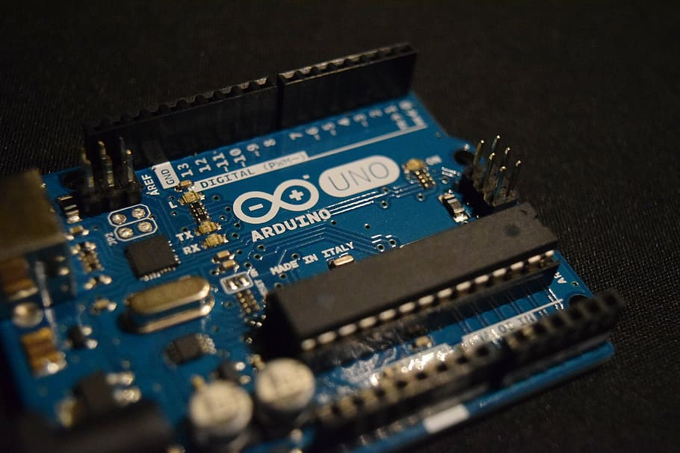
Arduino traffic light controller

Slide 4
Motivation And
Background
The use of personal vehicles is very common now a days and a result, the number of vehicles on the roads are exponentially increasing. Roads without any supervision or guidance can lead in to traffic congestions and accidents.Traffic Lights or Traffic Signals are signalling devices that are used to control the flow of traffic. Generally, they are positioned at junctions, intersections, ‘X’ roads, pedestrian crossings etc. and alternate the priority of who has to wait and who has to go.The traffic lights will provide instructions to the users (drivers and pedestrians) by displaying lights of standard color. The three colors used in traffic lights are Red, Yellow and Green.
The system must be used to control the traffic lights for smooth and safe movement of traffic. These control systems consists of electro mechanical controllers with clockwork mechanisms or modern solid state computerised systems with easy setup and maintenance.In this project, an Arduino based Traffic Light Controller system is designed. It is a simple implementation of traffic lights system but can be extended to a real time system with programmable timings, pedestrian lighting etc.

Slide 5
Traffic congestion continues to grow significantly throughout the world. Agencies tasked with managing traffic control systems are frequently challenged with moving traffic in congested conditions and situations where the traffic demand exceeds the capacity of the system.The majority of agencies involved in the operation maintenance of traffic signal systems are streched thin and challenged to provide adequate service to drivers in their jurisdictions. So we have tried to design a four way traffic light small scale module using Arduino to overcome the excess traffics on cross-roads.

Slide 6
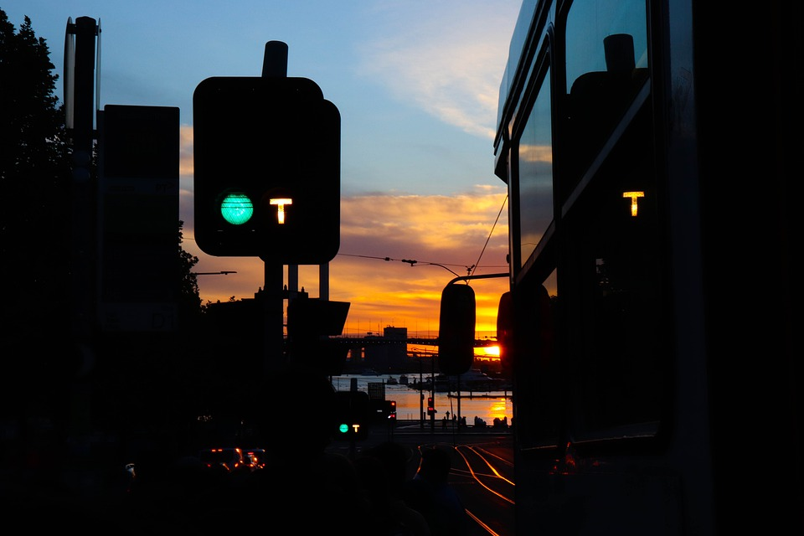
Currently Available Technology In
Traffic Light System
Traditionally, incandescent and halogen bulbs were used but they were replaced by LEDs which served as advantage due to Power efficiency but now for safety concerns heating device on lens has to be developed.
Many remote traffic lights operates on timer.

Slide 7
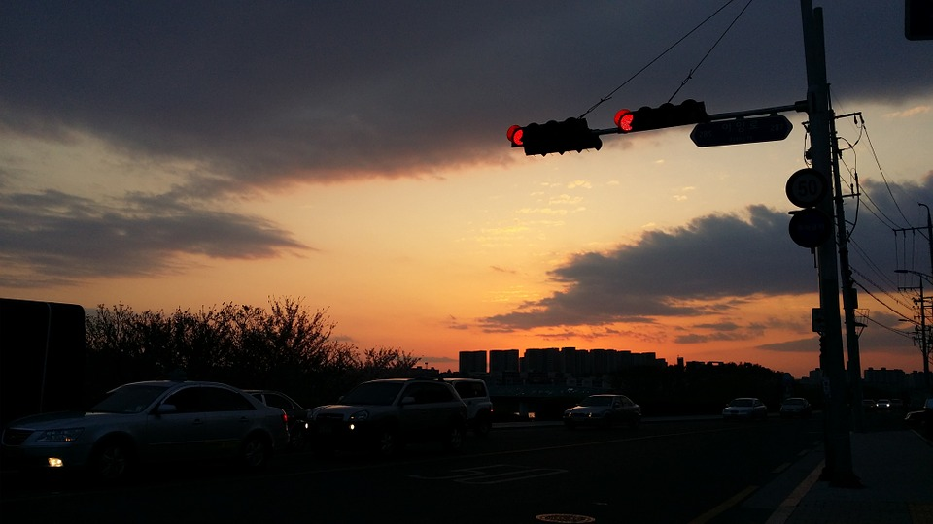
Many places actuated signals are being used , they receives Information from various sensors like cameras , radars and sometimes weight sensors on the road and are capable of making real time decisions about light timing and sequence.
The traffic detection signals may also have sensors to identify emergency vehicles and to allow it to go at earliest.

Slide 8
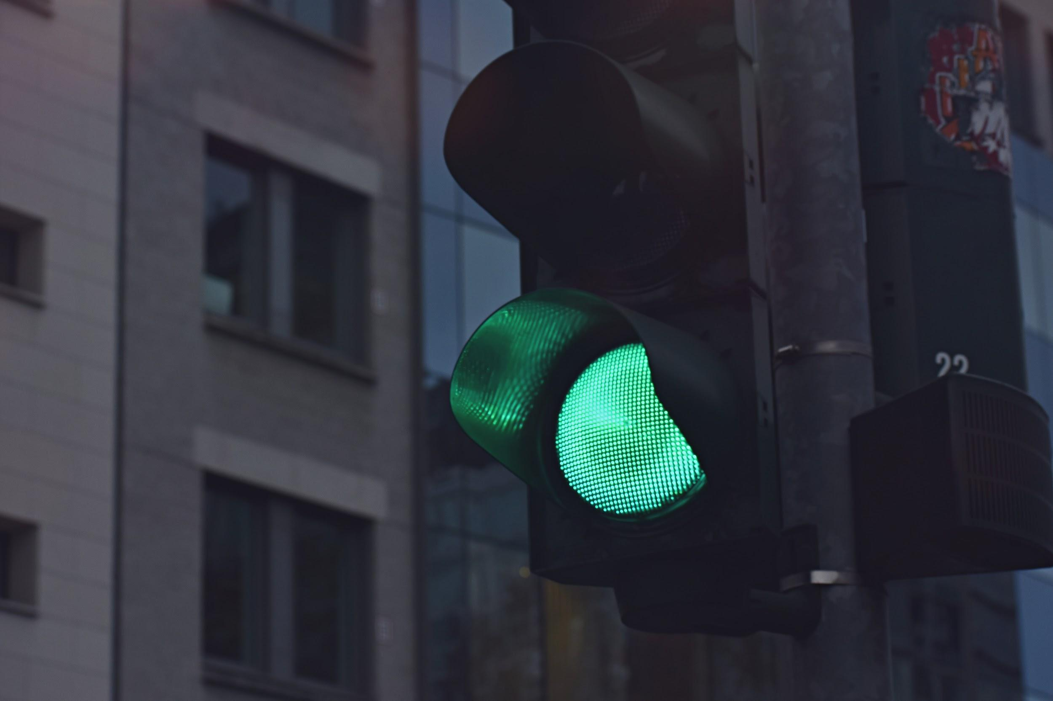
Salient Features
It is a simple implementation of the four-way traffic light system.
Arduino board will handle all the switching of the LEDs and control their timings.
It uses energy from the laptop as the power source.
Arduino IDE software was used to program the Arduino board.

Slide 9
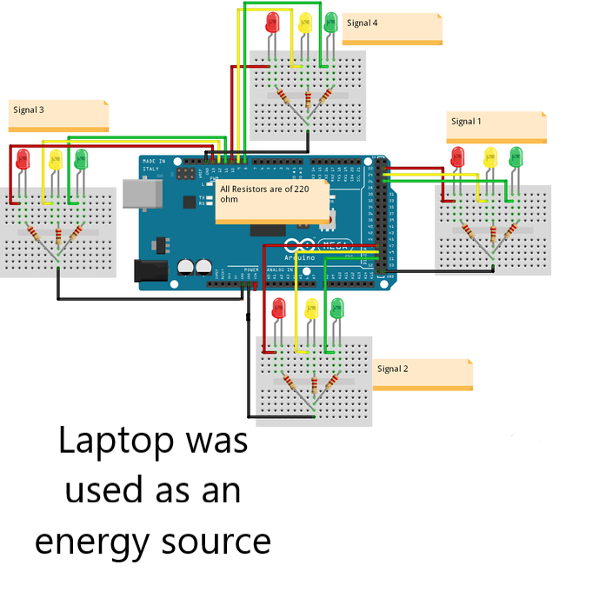
CIRCUIT DIAGRAM

Slide 10
Component | Price | Quantity | Total Price
Arduino Mega 2560 | 793.00/- | *1 | 793.00/-
Red LED(5mA,1.9V) | 2.00/- | *4 | 8.00/-
Yellow LED(5mA,1.9V) | 2.00/- | *4 | 8.00/-
Green LED(5mA,1.9V) | 2.00/- | *4 | 8.00/-
220 ohm Resistors | 0.45/- | *12 | 5.40/-
Jumper Cables(20cm) | 2.00/- | *20 | 40.00/-
BreadBoard(17cm*6cm) | 90.00/- | *4 | 360.00/-
 |  |  | 1222.40/-

Slide 11
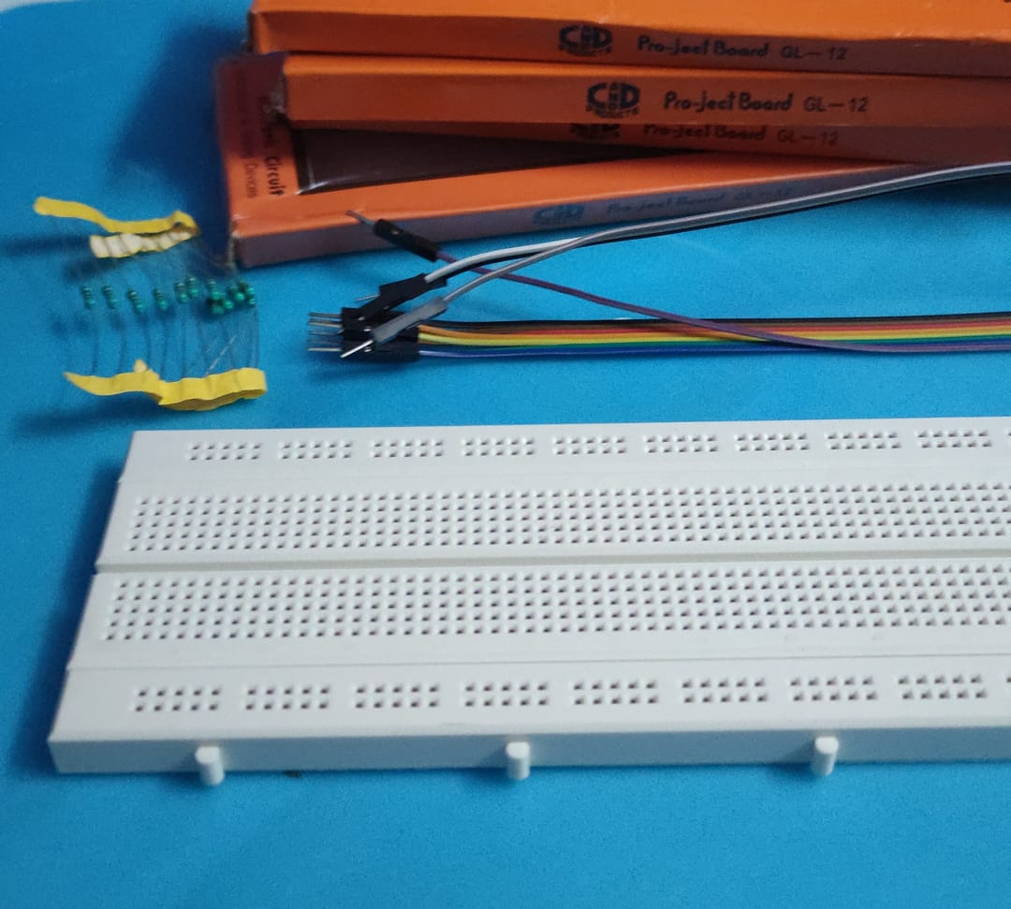
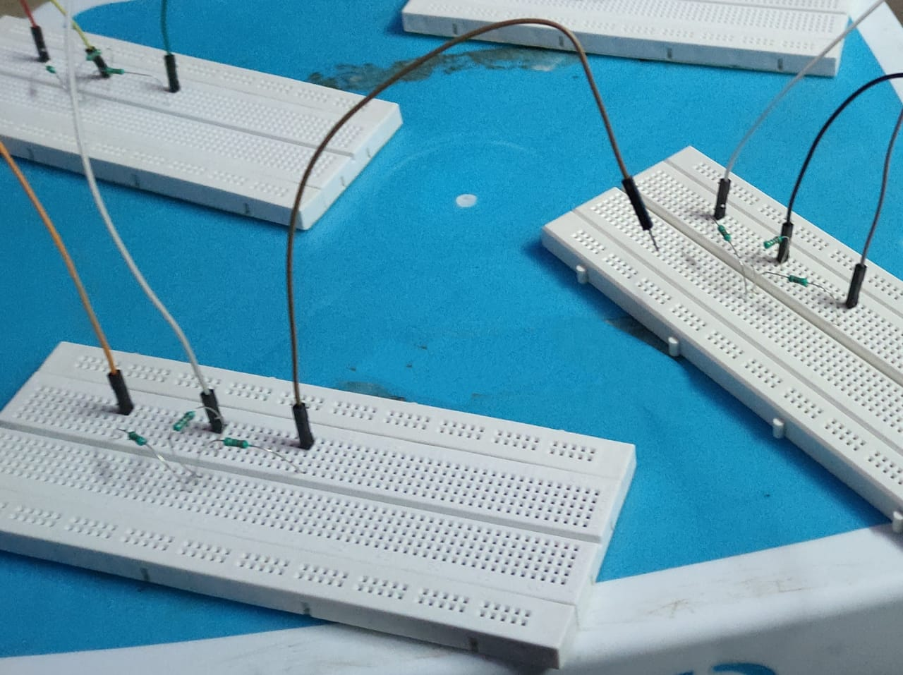
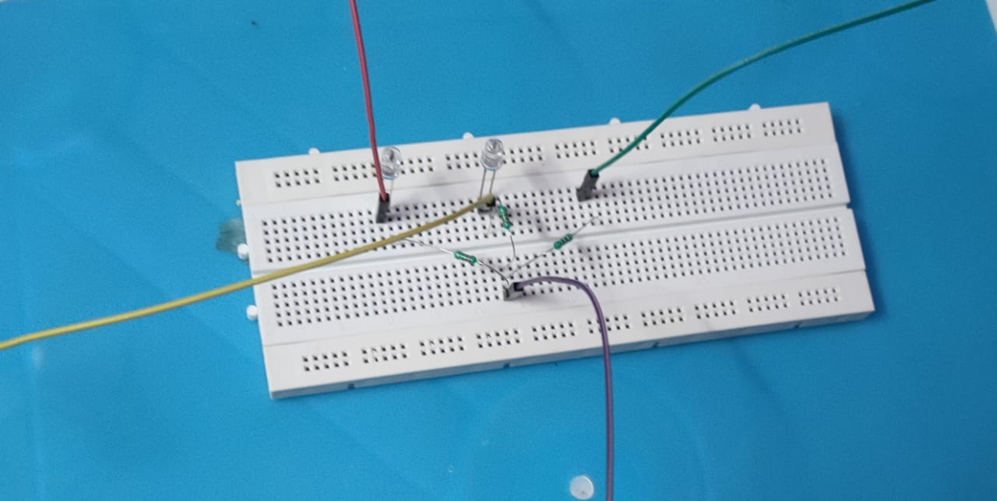
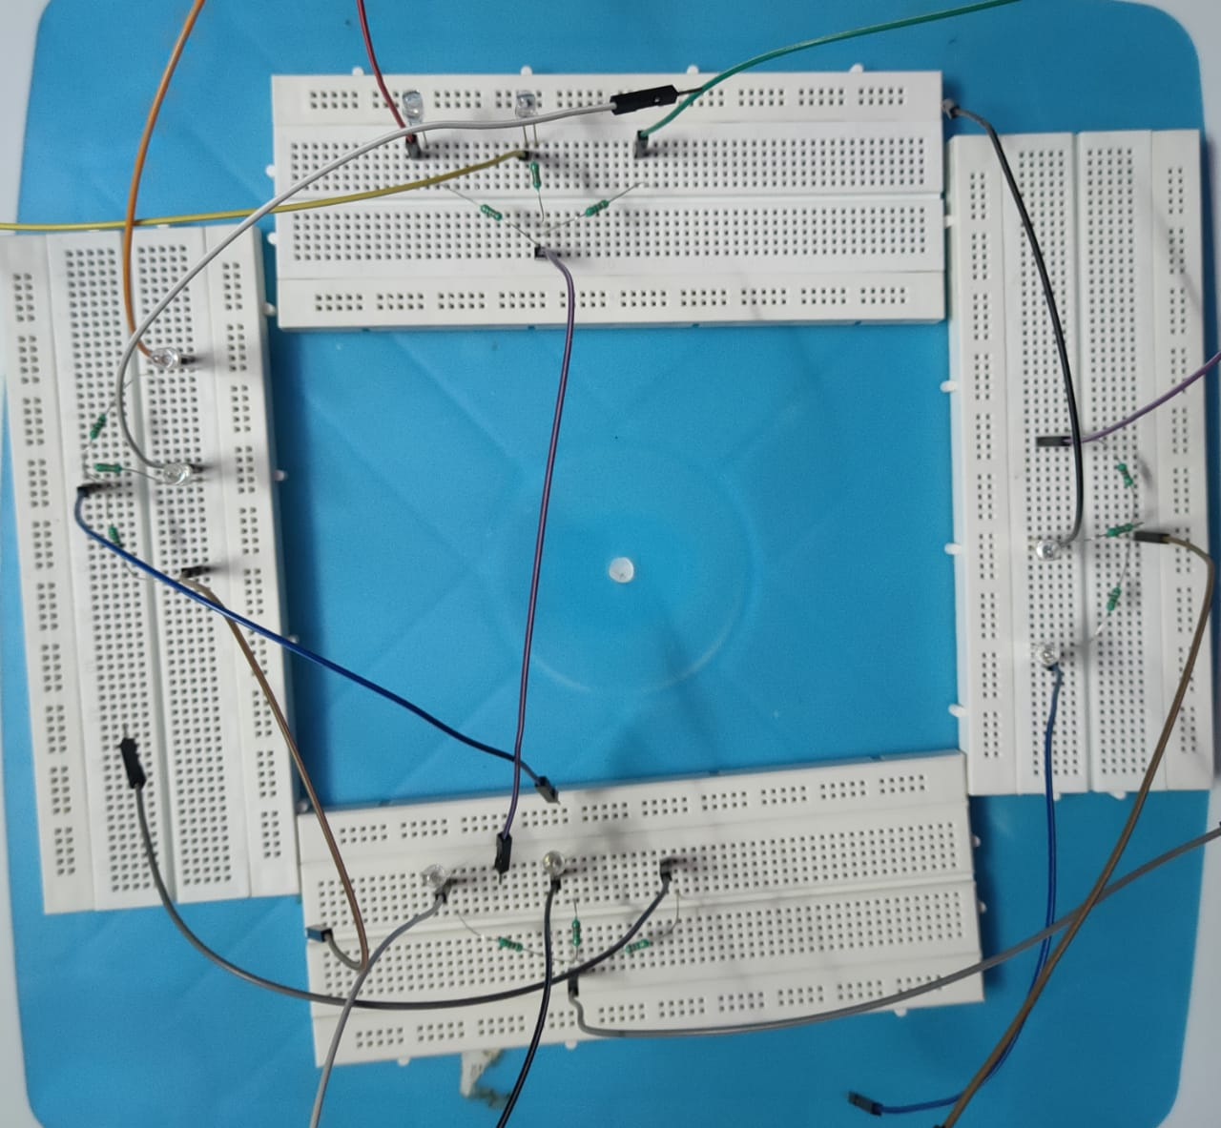
PROCESS OF ASSEMBLING

Slide 12

Software Used
Arduino IDE
It was used to upload the code to the Arduino Mega 2560 board

Slide 13
Process which we followed to complete our project
After having received all the components
Connection of LEDs to the breadboard were made
Connection of Jumper Cables with breadboard were made
Resistors were connected to the breadboard to limit the current passing through LEDs
Code was uploaded to the Arduino Mega 2560 board using the software Arduino IDE
Connected jumper cables to different pins of Arduino board as shown in the circuit diagram
Ran some sample experiments
Ran the final experiments and made the video explaining our project

Slide 14
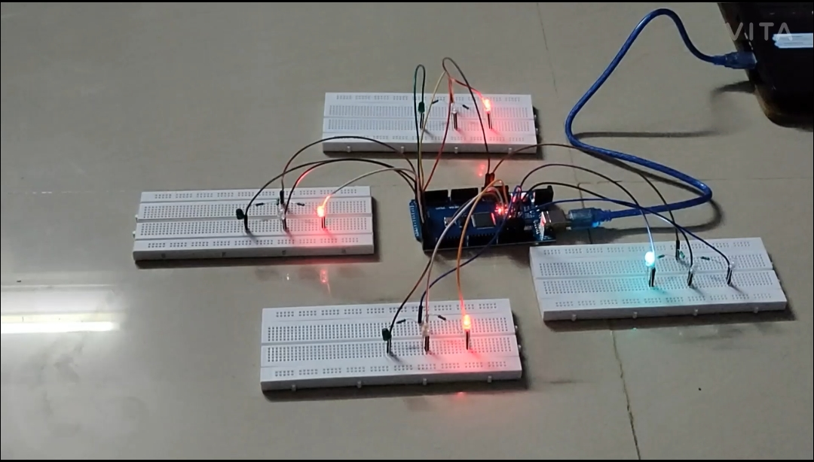
FINAL CIRCUIT

Slide 15
WORKING
So at start, green light of signal 1 and red lights at other signals will light up to give time to the vehicles at signal 1 to pass.
After 5 seconds, the yellow light at signal 1 will light up to give an indication that the red light at signal 1 is about to come up and also to give an indication to the vehicles at signal 2 that the green light is about to light up.
So after 2 seconds, red light at signal 1 will come up and green light at signal 2 will come up meaning vehicles at signal 1 must stop and vehicles at signal 2 can move.
Similarly the traffic light controller will work for the signal 3, signal 4 and the system will keep looping.

Slide 16
There are total of 12 LEDs used in this project. Each signal has 3 LEDs (Red, Yellow and Green) connected to it through the 220 ohm resistors.
The resistors are used to limit the current that is going to pass through the LEDs. If we won’t use the resistors then the LEDs may burn due to excessive current.

Slide 17

What we learned while Doing the project
Coding of an Arduino Board.
Using Arduino IDE Interface.
Using of Bread Board and how to make connections on it.
Variations of output voltage from the Arduino board.

Slide 18
WORK DISTRIBUTION
Jahnavi Arnepalli
Mudita Srivatsa
Ordering of components
Assembling of components
Implementing the Code on Arduino IDE
Video preparation
Making of PPT and Presentation
Research work (Finding relevant information regarding the project)
Akshat Soni
Vasav
Modification of Code according to project specifications
Making PPT and Presentation
Research work (Finding relevant information regarding the project)
Modification of Code according to project specifications
Making PPT and Report
Research work (Finding relevant information regarding the project)
Notes:
© Copyright PresentationGO.com – The free PowerPoint and Google Slides template library

Slide 19
WEEKLY PROGRESS REPORT
Week 1
Week 2
Week 3
Week 4
Gathering information regarding the project
Searching information regarding project including components required and code for the project.
Assembling of components.
Implementing of the code in UNO IDE interface.
Modifying and Debugging of code.
Preparation of report and video presentation.
Buying of components.
Notes:
© Copyright PresentationGO.com – The free PowerPoint and Google Slides template library

Slide 20
Video Demonstration
The whole project has been explained in a video and link to that video is :
https://youtu.be/lAGHTHw9WTo
References
https://www.electronicshub.org/arduino-traffic-light-controller/
https://create.arduino.cc/projecthub/muhammad-aqib/how-to-build-an-arduino-traffic-light-controller-4-way-184aa1
https://www.instructables.com/Arduino-Street-Traffic-Light/

Slide 21


